Slide 1
SCADA Home Security
STEM Outreach
By
Jonathan Beason, Ben Curths, Simone Gbouomou
Ben McAnulty, Chad Bryan, Ben Calvert
CPE 496 Computer Engineering Design II
CPE 489 Cybersecurity Engineering Capstone II
Electrical and Computer Engineering
The University of Alabama in Huntsville
Notes:
Ben 1

Slide 2
Team Members
Ben Calvert
Jon Beason
Simone Gbouomou
Ben McAnulty
Cybersecurity Engineering
Computer Engineering
Ben Curths
Chad Bryan

Slide 3
Project Summary
The SCADA Home Automation System is a physical and interactive education model designed to emulate today’s smart home systems. The purpose of the project is to introduce and generate interest in cybersecurity among students and young professionals through the use of an interactive model. By creating an interactive model, the students and young professionals will be able to see the effects of cyber-attacks manifested in a physical manner. To accomplish the project objectives, a solenoid, stepper motor, and sensors will be integrated using Arduino microcontrollers running OpenPLC. In addition, a Human Machine Interface (HMI) will be used to control and monitor the SCADA Home Automation System. Students and young professionals will have the opportunity to interact with the system through physical interactions with the model and by performing cyber-attacks on the system.

Slide 4
Our Mission was to create an interactive model of a home that uses a SCADA network to emulate a smart home and its functionality. Supervisory Control And Data Acquisition (SCADA) networks are commonly used in manufacturing plants, power centers, pipelines, and other critical infrastructure to network together sensors, servos, and Programmable Logic Controllers to provide real-time control and monitoring of a physical system. In our model, we have various doors and sensors that could be found in a smart home’s security system. These are controlled from the Human Machine Interface (HMI) which displays their status and allows for user input. Additionally, we have a network access port where a host can interact with the internal SCADA network and demonstrate cybersecurity attacks. We have also developed mitigations to these attacks, which can be toggled on and off. Our sponsor will use the model at conferences, schools, and on campus to demonstrate common vulnerabilities in SCADA systems and how they can be remediated.

Slide 5
Results and Conclusions
Our project was completed on time, meeting our requirements and implementing all the desired functionality.
Everyone on our team learned a great deal about SCADA systems, teamwork and coordination, and organizing milestones to track the project’s overall progress.
Our project will be used by Dr. Coe and other staff in the UAH Engineering department to provide a demonstration of SCADA system functionality and common cyberattacks and mitigations.
Future work could include a wider range of cyberattacks/mitigations, more detail in the home model, and a greater user interaction with the system.

Slide 6
Purpose
Create an interactive Home Security model that demonstrates the principles of SCADA systems in an manner that is familiar with the target audience.
Demonstrate the vulnerabilities of critical SCADA systems such as Dams, Power Plants and Pipelines by performing cyber attacks on more familiar systems.
Generate interest in Cybersecurity/Computer Engineering among students and young professionals.
Promote UAH by highlighting skills/knowledge gained through attending UAH’s College of Engineering.
Notes:
Ben 1

Slide 7
Marketing Requirements
Technical
SCADA system built using OpenPLC, Modbus and Ladder Logic. Monitor the system using an Human Machine Interface (HMI).
Hacks
Hollywood style movie hacks, Physically/Visually changes the state of the product. Non-technical style hacks that are easy to understand/implement.
Patchable
Easy to patch or mitigate the vulnerability of the SCADA system.
Flashy
Multiple changing lights, makes sounds including alarms or buzzer, and looks visually interesting.
Interactive
Moveable components with reactive feedback.
Portable
Lightweight, Ergonomic, Easy to set up, and Simple to use
Notes:
Ben 1

Slide 8
Marketing Requirements 2
Flashy
Multiple changing lights, makes sounds including alarms or buzzer, and looks visually interesting.
Interactive
Moveable components with reactive feedback.
Portable
Lightweight, Ergonomic, Easy to set up, and Simple to use
Notes:
Ben 1

Slide 9
Journal Papers I
The following journal paper details the need to bring Computer Science into classrooms, [1] specifically using physical models which are more appealing to young students.
The study was conducted by the United States Naval Academy (USNA) STEM Outreach program to target the growing need for CS graduates.
The goal was to [1] promote interest and properly educate students about cybersecurity topics utilizing modules that can be interacted without using a computer.
These modules were able to effectively teach students about cybersecurity concepts in an effective and visual way.
Reference: [1] R E Fees, J A da Rosa, S S Durkin, M M Murray, A L Moran. (2018, January). "Unplugged Cybersecurity: An approach for bringing computer science into the classroom, " Vol. 2, No. 1. Available: https://www.usna.edu/STEM/_files/documents/Unplugged-Cyber-Security_2018.pdf

Slide 10
Journal Papers II
Here is another Journal Paper which supports our mission of spreading awareness about SCADA systems and their cybersecurity weaknesses.
This study utilizes various demonstrations in order to [2] simulate physical cybersecurity processes in a physical manner.
These demonstrations utilized various software applications to [2] implement various forms of cybersecurity attacks.
Reference: [2] Maxime Puys, Pierre-Henri Thevenon, Stéphane Mocanu, Mathieu Gallissot, Camille Sivelle. SCADA
cybersecurity awareness and teaching with Hardware-In-The-Loop platforms. Journal of Wireless Mobile Networks, Ubiquitous Computing, and Dependable Applications, 2022, 13 (1), pp.4-32.10.22667/JOWUA.2022.03.31.004.hal-03636896, Available: https://hal.science/hal-03636896/document

Slide 11
Journal Papers III
“The Power of Hands-On Exercises in SCADA Cyber Security Education”
Describes a learning approach that emphasizes the importance of active participation in hands-on exercises and experiential learning in SCADA cybersecurity.
Paper authors have developed an intensive course during which students examine PLC logic and the modbus protocols before attacking and/or defending a simulated traffic control system.
Attacks occur in two phases: one against a “highly vulnerable” network and the second against a hardened “less vulnerable” network.
Reference: [3] Sitnikova, Elena & Foo, Ernest & Vaughn, Rayford. (2013). The Power of Hands-On Exercises in SCADA Cyber Security Education. 406. 83-94. DOI: 10.1007/978-3-642-39377-8_9.

Slide 12
Patents
Using the US Patent and Trademark Office search engine, results yielded patents to non-educational applications, so therefore no patents directly related to our project were found.
The following patent was found that most closely references a SCADA system in the application of [3] fluid actuator systems.
The systems were tested and monitored utilizing systems that employed SCADA systems to collect data on various statuses.
Patent Referenced: [3] "CONTROL OR REGULATING SYSTEMS IN GENERAL; FUNCTIONAL ELEMENTS OF SUCH SYSTEMS; MONITORING OR TESTING ARRANGEMENTS FOR SUCH SYSTEMS OR ELEMENTS, " United States of America + CPC Subclass G05B, Febuary 2023. Available: https://www.uspto.gov/web/patents/classification/cpc/pdf/cpc-scheme-G05B.pdf

Slide 13
Market Research
Other related projects and demonstrations include:
Real Operation Demo with ICS/SCADA Demo Kit
NSHC Security’s simulated industrial control system with HMI interactivity.
https://youtu.be/K-BQyv0FO9I
SCADASim Training Simulator
Software Engineering Institute’s software-based SCADA/ICS simulation that includes network traffic monitoring and deployable cyberattacks.
https://github.com/cmu-sei/SCADASim
https://youtu.be/htvypfqgeTg

Slide 14
Engineering Requirements
Physical Requirement
Overall Dimensions should be less the 3’ High x 2’ Wide x 2’ Deep
Design the Case and Home model to fit within the desired geometry.
Overall Weight should be less than 50 lbs.
Use light-weight material for Case and Home Model construction.
Should not consume over 120v 15 Amp
Calculate power consumption of electronic to keep with required range.
No electrical wires showing.
Enclose all wires
LCD Display should be 10”
Purchase a 10” LCD display that can be driven by a microcontroller.
Notes:
Maximum budget of 400, specified dimensions, plc software and interaction, LCD panel, re-usability LAN components

Slide 15
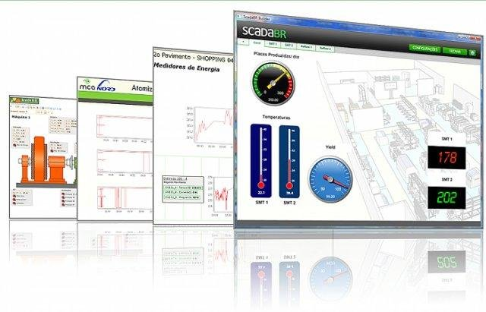
Engineering Requirements
System Software Requirements
The SCADA Programmable Logic Control (PLC) elements are to be implemented using OpenPLC Controller Software.
The Controller PLC elements are to be configured using Ladder Logic
The HMI/Monitoring Controller elements are to be implemented using ScadaBR Software.
The Monitoring Controller elements are configured to control the home automation functionality through updates via the MODBUS communication protocol.
Notes:
Maximum budget of 400, specified dimensions, plc software and interaction, LCD panel, re-usability LAN components

Slide 16
Engineering Requirements
System Level Electronic Hardware Requirements
Two PLCs that are interfaced together using 1 Gbit/sec Ethernet hub.
PLC hardware is implemented using a Raspberry Pi.
The Monitor PLC’s Raspberry Pi will receive input updates for the Controller PLC’s Raspberry Pi.
The Controller PLC’s Raspberry Pi is to be coupled to an Arduino Mega microcontroller which will in turn drive all of the following sensor/actuator devices.
Device List
Infrared Break Sensor
Magnetic Sensor
PIR Motion Sensor
LED Lights
Solenoid
Electronic Deadbolt
315 MHz RF Receiver
DC Motor
Micro Lever Switch.
Notes:
Maximum budget of 400, specified dimensions, plc software and interaction, LCD panel, re-usability LAN components

Slide 17

Engineering Requirements: Cyber
Cyber Attacks
Two cyber attacks performed on the home automation system which will be executed via a VM box on a laptop connected to the network via Ethernet.
An ARP poisoning attack will be performed to poison the ARP table of the machine hosting the HMI so we can act as a Man In The Middle (MITM) between the HMI and the PLC
A code injection attack is to be performed by writing a python script to send spoof packets to the SCADA system to perform unauthorized tasks.
Notes:
Maximum budget of 400, specified dimensions, plc software and interaction, LCD panel, re-usability LAN components

Slide 18

Engineering Requirements: Cyber II
Cyber Mitigations
The are two mitigation techniques to stop the cyber attacks from happening.
To mitigate the ARP poisoning, we made the ARP table on the HMI device static to prevent any changes.
Mitigation for the injection attack is to whitelist only the IPs of the system devices

Slide 19
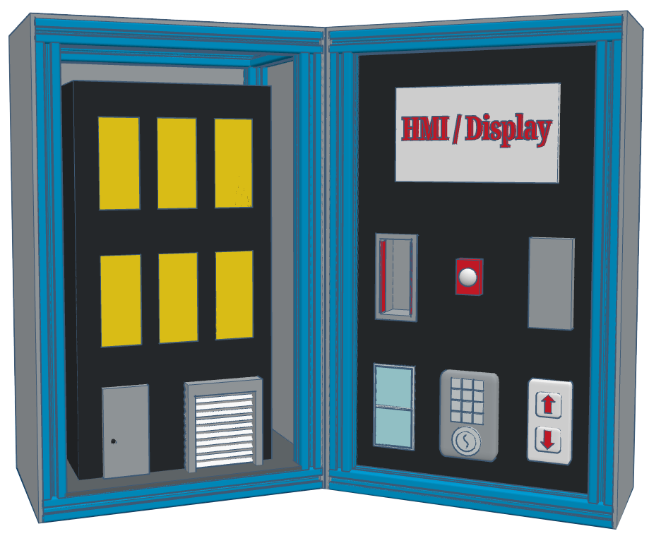
SCADA Home Automation Model
Protective Case
HMI / Display Monitor
Model Home
Alarm Light
Controllable lights
Motion Sensor
Smart Front Door
IR Sensor
Garage Remote
Garage Door
Magnetic Window Sensor
Smart Deadbolt
Notes:
Ben 1

Slide 20
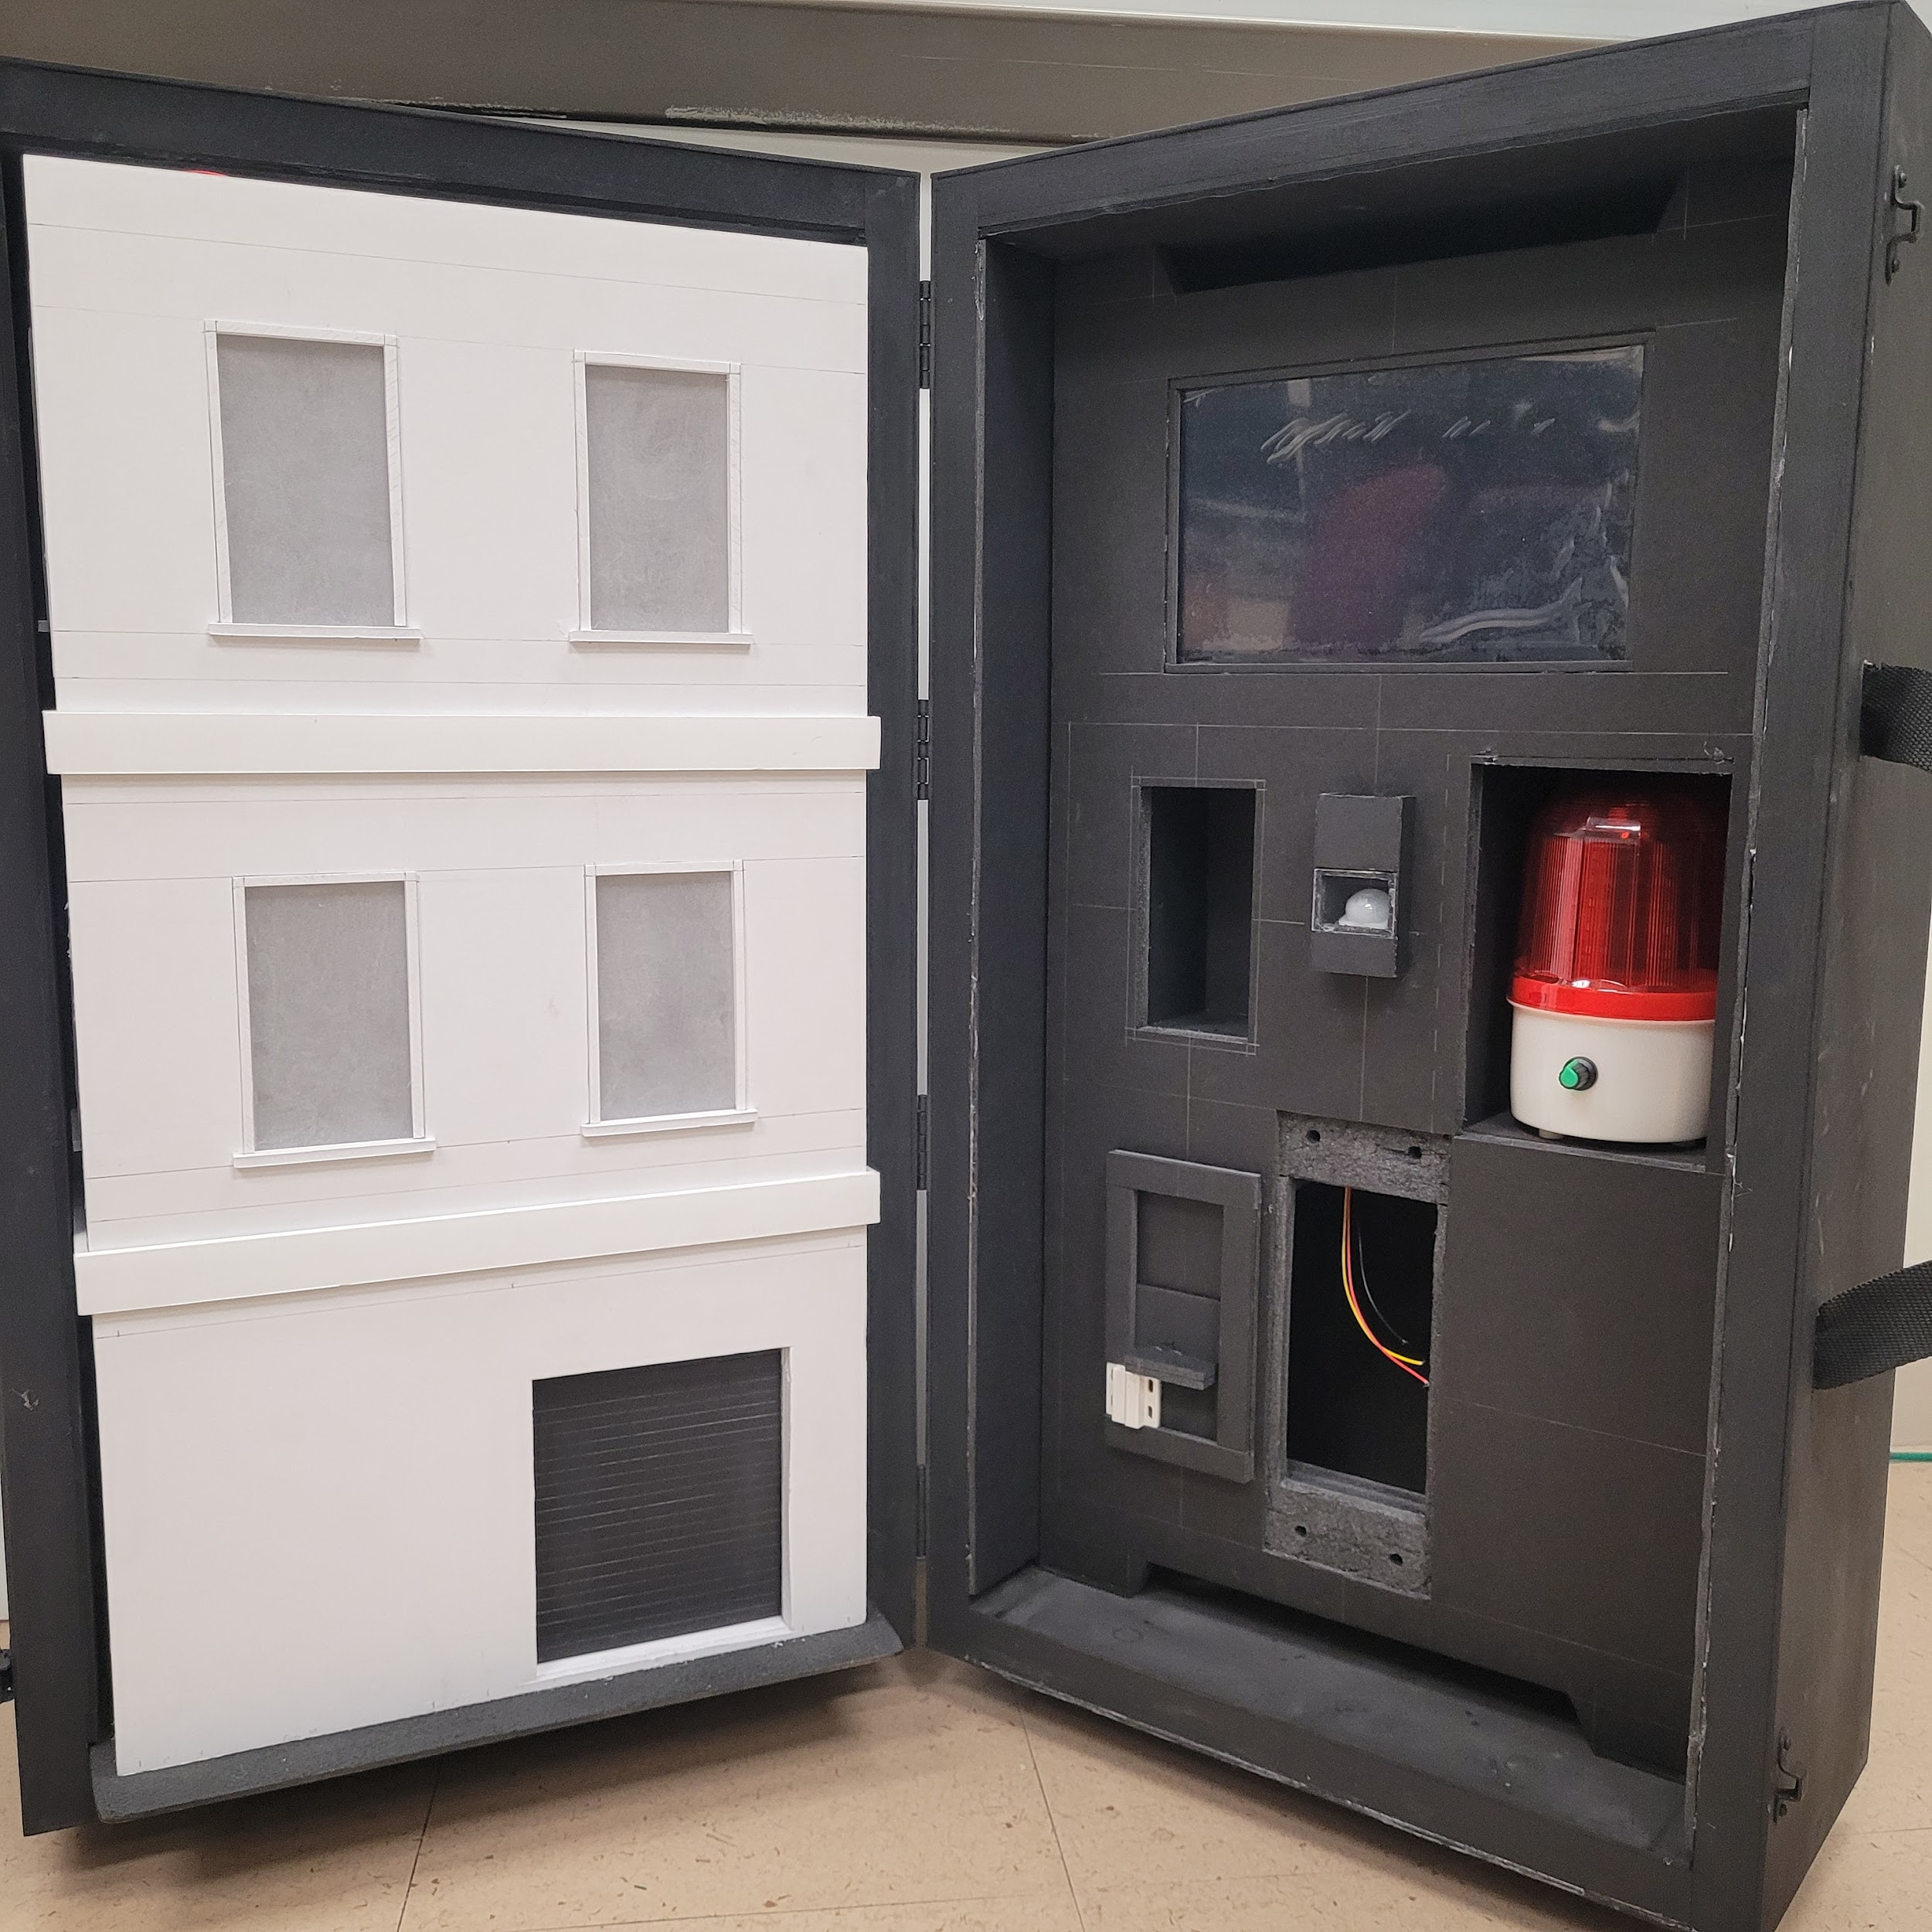
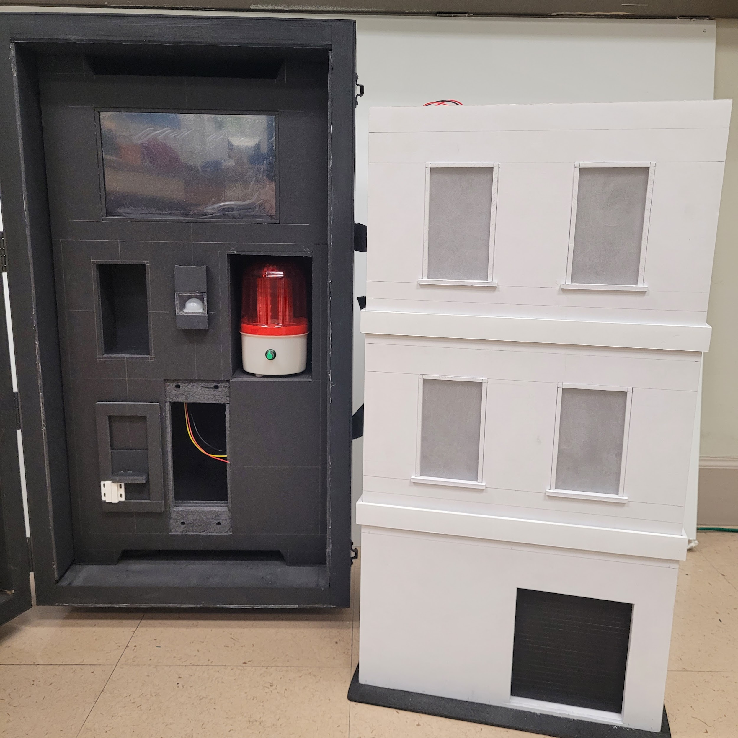
Results

Slide 21
Alternative Solutions
Elevator Project
Description
A two cart elevator system that would move up or down to pick up people and would include buttons for floor selection.
Reason for not selecting
Previous elevator design was to big to be portable and would need to be re designed/built.
Did not think the end product would be the flashy/cool marketing requirement.
Sponsor wanted to something other than an elevator.

Slide 22
Alternative Solutions
Elevator Project Picture
Add picture of the elevator project from the lab here.

Slide 23
Alternative Solutions
Nuclear Power Plant
Description
A thermal nuclear power plant with light up fuel rods and cooling tower.
Reason for not selecting
Felt the project my not be very relatable to the target audience.
A nuclear power plant uses water for heat exchange and cooling but transporting water in a model could be bad.
Needing to fill/drain water would reduce our ability to meet the easy setup marketing requirement.

Slide 24
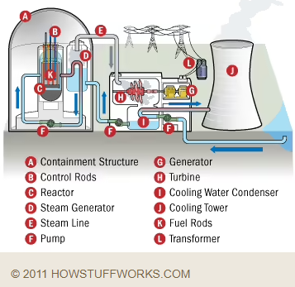
Alternative Solutions
Nuclear Power Plant Picture

Slide 25
Alternative Solutions
Manufacturing Plant
Description
Demonstrate various systems that are used in production plants such as conveyor belt, actuator, motion sensor.
Reason for not selecting
Felt the idea may not relate well with the targeted audience since high school students may not be familiar with production plants.
Concerned about being able to transport it and it remain intact/working.

Slide 26
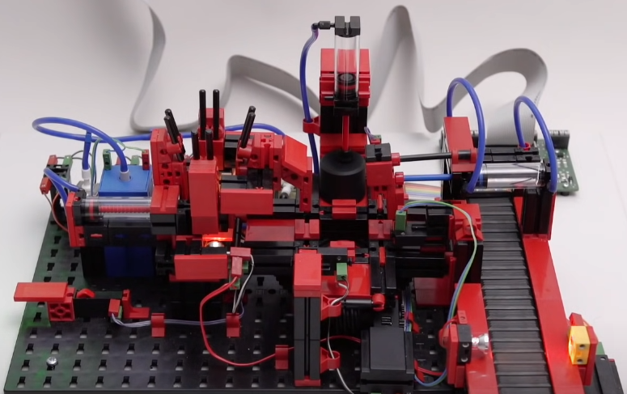
Alternative Solutions
Manufacturing Plant Picture

Slide 27
System Design Description
The deliverable will be a portable case that contains a model home with multiple physical security controls commonly found in modern households.
These security controls will send their current states to a HMI displayed in the case.
During a demonstration of our device, cyber attacks will be conducted which allow unauthorized access or undesirable function in the model home.
These attacks will be conducted from an external computer connected through a network hub attached to the case.

Slide 28
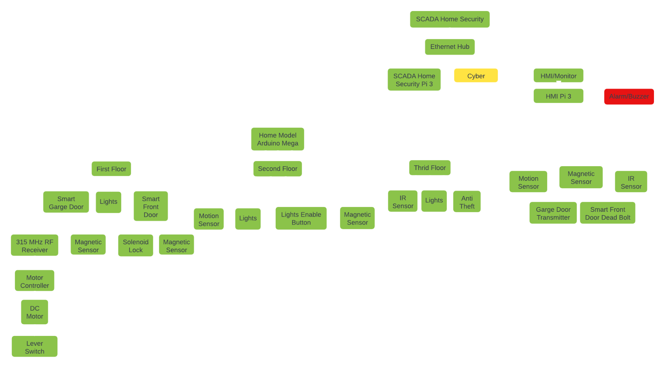
Functional Decomposition I

Slide 29
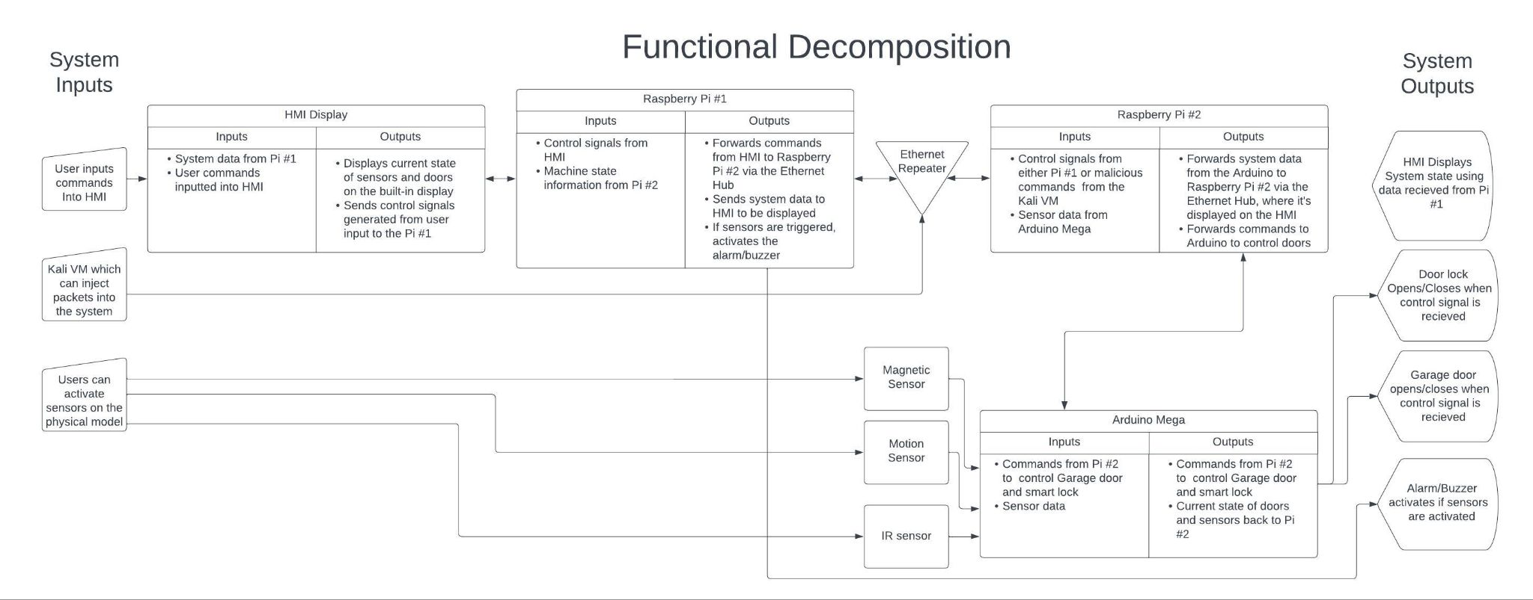
Functional Decomposition II

Slide 30
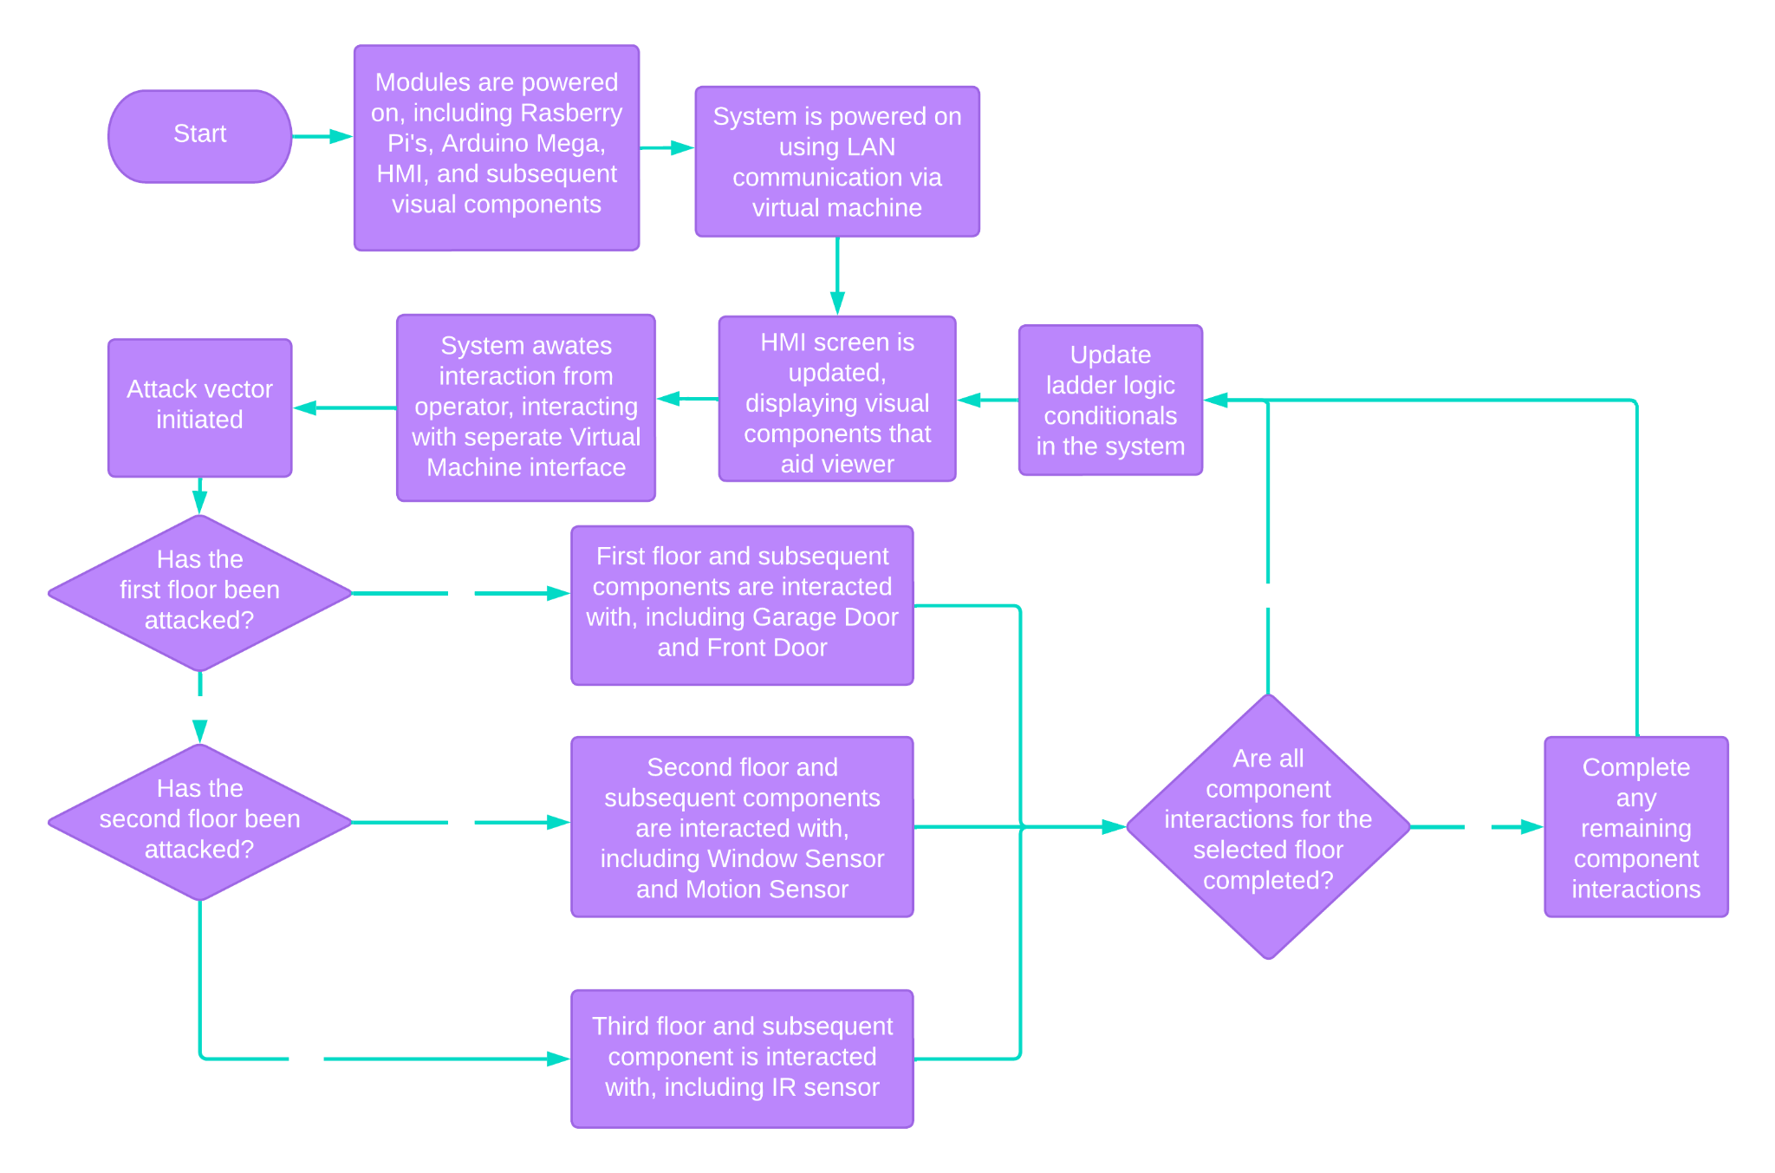
Behavioral Decomposition

Slide 31
Cybersecurity Component
The model system will be analyzed for security vulnerabilities.
At least two cyber attacks will be developed as part of the project requirements.
These attacks will be deployable and their effects observable in real time as part of the model’s demonstrative function.
Mitigation countermeasures will also be developed and may be deployed during the model’s use to render the developed attacks ineffective.

Slide 32
Testing Plan - Unit Tests I
Component | Purpose of Test | Pass Conditions
U01 - Magnetic Sensors (Front and Garage Doors) | Verify functionality of both magnetic switch sensors used to detect open doors. | Positive signal test (high signal on sensor trip). Negative signal test (low signal while sensor is not tripped).
U02 - PIR Sensor | Verify functionality of the passive IR motion detector. | Positive signal test. Negative signal test.
U03 - IR Beam Sensor | Verify functionality of the IR beam-break sensor. | Positive signal test. Negative signal test.
U04 - Front Door Motor | Verify functionality of the front door control. | Door opens on command. Door closes on command. Motor operates within expected range of motion.
U05 - Garage Door Motor | Verify functionality of the garage door control. | Door opens on command. Door closes on command. Motor operates within expected range of motion.

Slide 33
Testing Plan - Unit Tests II
Component | Purpose of Test | Pass Conditions
U06 - Lighting | Verify functionality of the model’s LED lighting. | All LEDs illuminate in the model when active. LED on/off state can be controlled via PLC.
U07 - ScadaBr | Verify initial installation of ScadaBr on RaspberryPi 4. | Software deploys, boots, and runs without error on the target platform.
U08 - OpenPLC | Verify initial installation of OpenPLC on Arduino Mega 2560r3 | Software deploys, boots, and runs without error on the target platform.
U09 - HMI Display | Verify correct functionality of the Human-Machine Interface screen. | HMI correctly displays the system status from ScadaBr without error.

Slide 34
Testing Plan - Integration Tests
Component | Purpose of Test | Pass Conditions
I01 - OpenPLC-ScadaBr | Verify communication and control functionality between OpenPLC and ScadaBr. | ScadaBr correctly reports the current sensor status. OpenPLC correctly executes commands sent from ScadaBr. ScadaBr correctly reflects changes in sensor status with minimal delay.
I02 - HMI-ScadaBr | Verify correct functionality of the HMI. | HMI correctly allows control input to ScadaBr. HMI correctly reports changes in system status to the user.
Regression testing will be performed on all components as each subsystem is integrated into the overall model.

Slide 35
Testing Plan - Cybersecurity
Component | Purpose of Test | Pass Conditions
C01 - DoS Attack | Verify/Demonstrate a denial-of-service attack against the system. | Deployed attack successfully prevents or disrupts user control of the system components.
C02 - Spoofing Attack | Verify/Demonstrate a command spoofing attack against the system. | Deployed attack is able to successfully issue unauthorized commands that are then executed by the system.
C03 - DoS Mitigation | Verify successful defense against the previously developed denial-of-service attack. | When mitigation measures are active, the previously successful DoS attack must not prevent user control of the system.
C04 - Spoofing Mitigation | Verify successful defense against the previously developed spoofing attack. | When mitigation measures are active, the system must not respond to unauthorized command signals.
Note that all cybersecurity attack vectors and mitigations are still under development and subject to change.

Slide 36
Testing Plan - Acceptance Tests
Component | Purpose of Test | Pass Conditions
A01 - Size and Portability | Verify that the completed system meets the size and portability restraints. | Closed system fits within 3’x2’x2’ space and weighs less than 50lbs. System operates on a single standard 120V 60Hz power supply and draws less than 15A when fully operational.
A02 - SCADA Functionality | Verify that the completed system performs the SCADA demonstration requirements. | All sensors correctly report the current state of the model. Current model state is correctly displayed on the HMI. User HMI commands are correctly executed by the system to change the model state.
A03 - Cybersecurity Functionality | Verify that the completed systems performs the cybersecurity attack and mitigation demonstration requirements. | Both DoS and Spoofing attacks correctly function when deployed against the vulnerable system. Both DoS and Spoofing attacks fail to function when deployed against the hardened system.

Slide 37
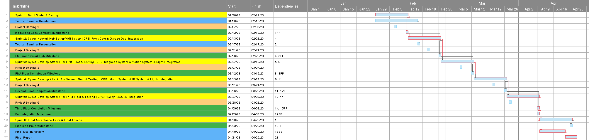
Project Timeline

Slide 38
Development Safety Analysis:
During development, we will be working with power tools, soldering equipment, and raw voltage. To mitigate the risk of cuts, burns, and electrical shocks, we will wear proper PPE while working.
End-User Safety Analysis:
Flashing lights could affect people that have photosensitive epilepsy. We will have a warning posted on the model indicating that it contains an alarm with bright flashing lights.
Environmental & Safety Analysis

Slide 39
Social Impact
The goal of our project is to generate interest in the field of cybersecurity, educate users in the basics of SCADA systems, and demonstrate common vulnerabilities that can be exploited in these systems.
Our sponsor, Dr. Coe, will be taking this model to conferences, seminars, and schools to provide a short, interactive, and educational presentation to students and young professionals.
He will be spreading awareness about SCADA systems and the cybersecurity challenges they are facing in the increasingly interconnected world of today.
Environmental & Social Impact
Environmental Impact
The LCA(life cycle assessment) study concluded that the largest impact of home energy management is the use phase of electricity consumption of home automation devices. Furthermore, the largest part of this is due to the energy consumption of smart plugs.
However, the research also showed that home automation could have a positive environmental impact by decreasing the peak load and shifting part of the energy consumption from daytime to nighttime.

Slide 40
Positive Project Impact
Raise awareness of vulnerabilities in SCADA systems
Promote UAH’s Cyber and Computer Engineering Departments
Introduce target audience to SCADA systems

Slide 41
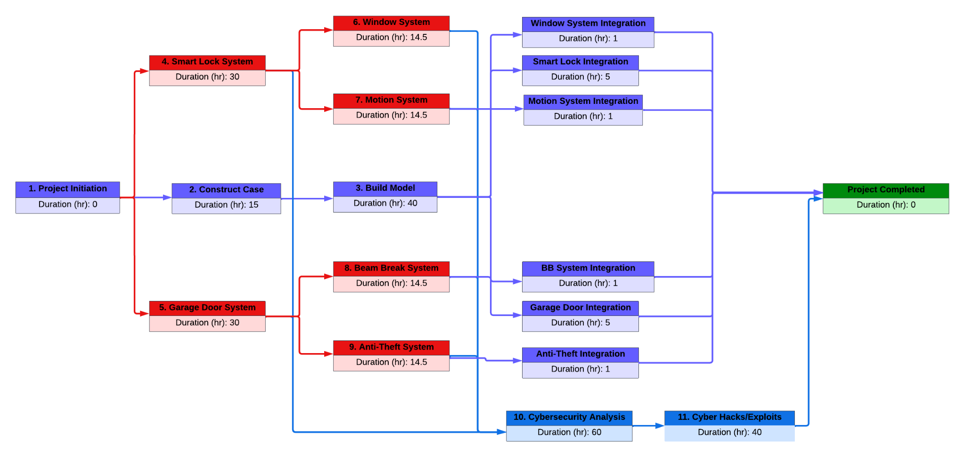
PERT Chart

Slide 42
Division of Responsibility
Ben Calvert
Case/Model Construction, Motion System, Cybersecurity Analysis, Cyber Hacks/Exploits
Ben Mcanulty
Model Construction, Motion System, Cybersecurity Analysis, Cyber Hacks/Exploits
Jonathan Beason
Project Initiation, Window System, Cybersecurity Analysis, Cyber Hacks/Exploits
Simone Gbouomou
Model Construction, Motion System, Cybersecurity Analysis, Cyber Hacks/Exploits
Ben Curths
Smart Lock System, Garage Door System, IR Sensor System, Anti-Theft System
Chad Bryan
Smart Lock System, Garage Door System, IR Sensor System, Anti-Theft System

Slide 43
Cost Estimation
Funding provided by the ECE Department: $400
Estimated labor cost in hours: 352 hours
Itemized price and expenses: $407
Fixed Cost: None
Variable Cost: Labor/Materials
The cost associated with the project can be seen broken down in Cost Analysis 1 & 2

Slide 44
Cost Analysis II
Software / Services
Labor Cost
Est.
Actual
OpenPLC Software Free
scadaBr/ Home - Assistant Free
Linux OS Free
Building Model 60 hrs
Building Case 60 hrs
Ladder Logic Programming 60 hrs
Circuit Prototyping 20 hrs
Integration 14 hrs
Testing 38 hrs
Cybersecurity Analysis 60 hrs
Cybersecurity Hacks 40 hrs
Total 352 hrs
100 hrs
55 hrs
80 hrs
60 hrs
54 hrs
60 hrs
60 hrs
40 hrs
509 hrs

Slide 45
Final Deliverables
Hardware:
“SCADA Home Security” Model
Interactive Components
Representative Model Building
Enclosure Case
Software:
PLC Ladder Logic Programming
ScadaBR Configuration
Documentation:
Product Documentation
User Manual
Component Technical References
Project Artifacts
Test Reports
Progress Reports
Meeting Notes

Slide 46
Current State of the Project
The Raspberry Pi’s and Kali VM are connected and running. The cybersecurity hacks can be deployed from the VM, and the mitigations can be toggled on/off as well.
The model construction is almost complete, and just requires integration of the sensors and other hardware.
We have individually tested and confirmed the IR, Motion, and Magnetic sensor are working, and have them connected to the Arduino Mega.
We have also reverse engineered the Smart Lock, and have it prepared for integration along with a prototype of the garage door.
A Ladder Logic program has been written, and once we have everything connected together we can deploy and test it on the Raspberry Pi.
Notes:
Jon

Slide 47
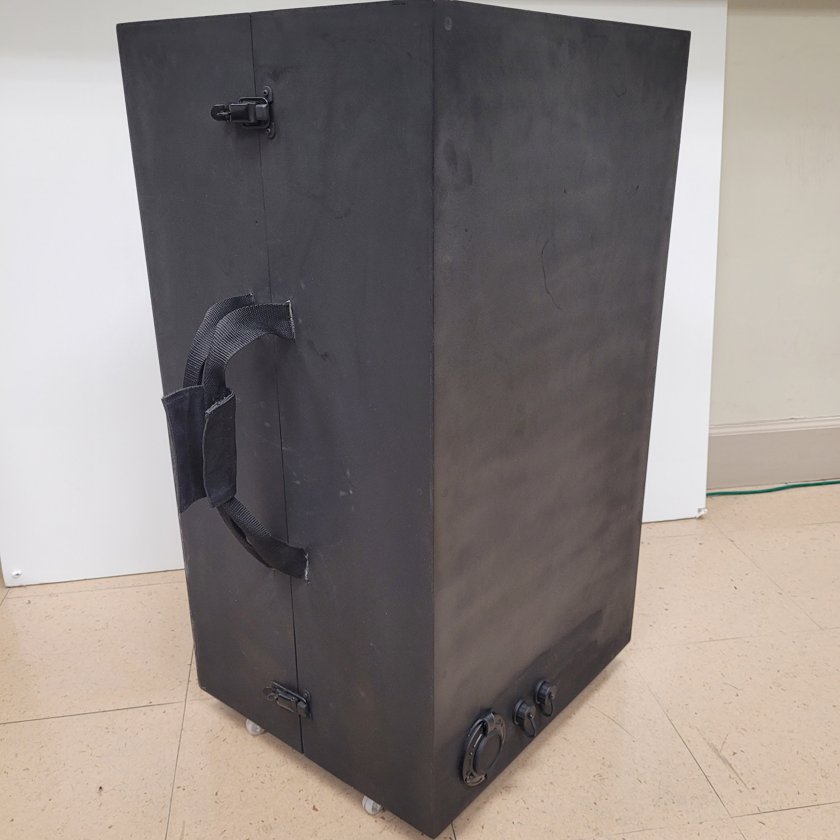
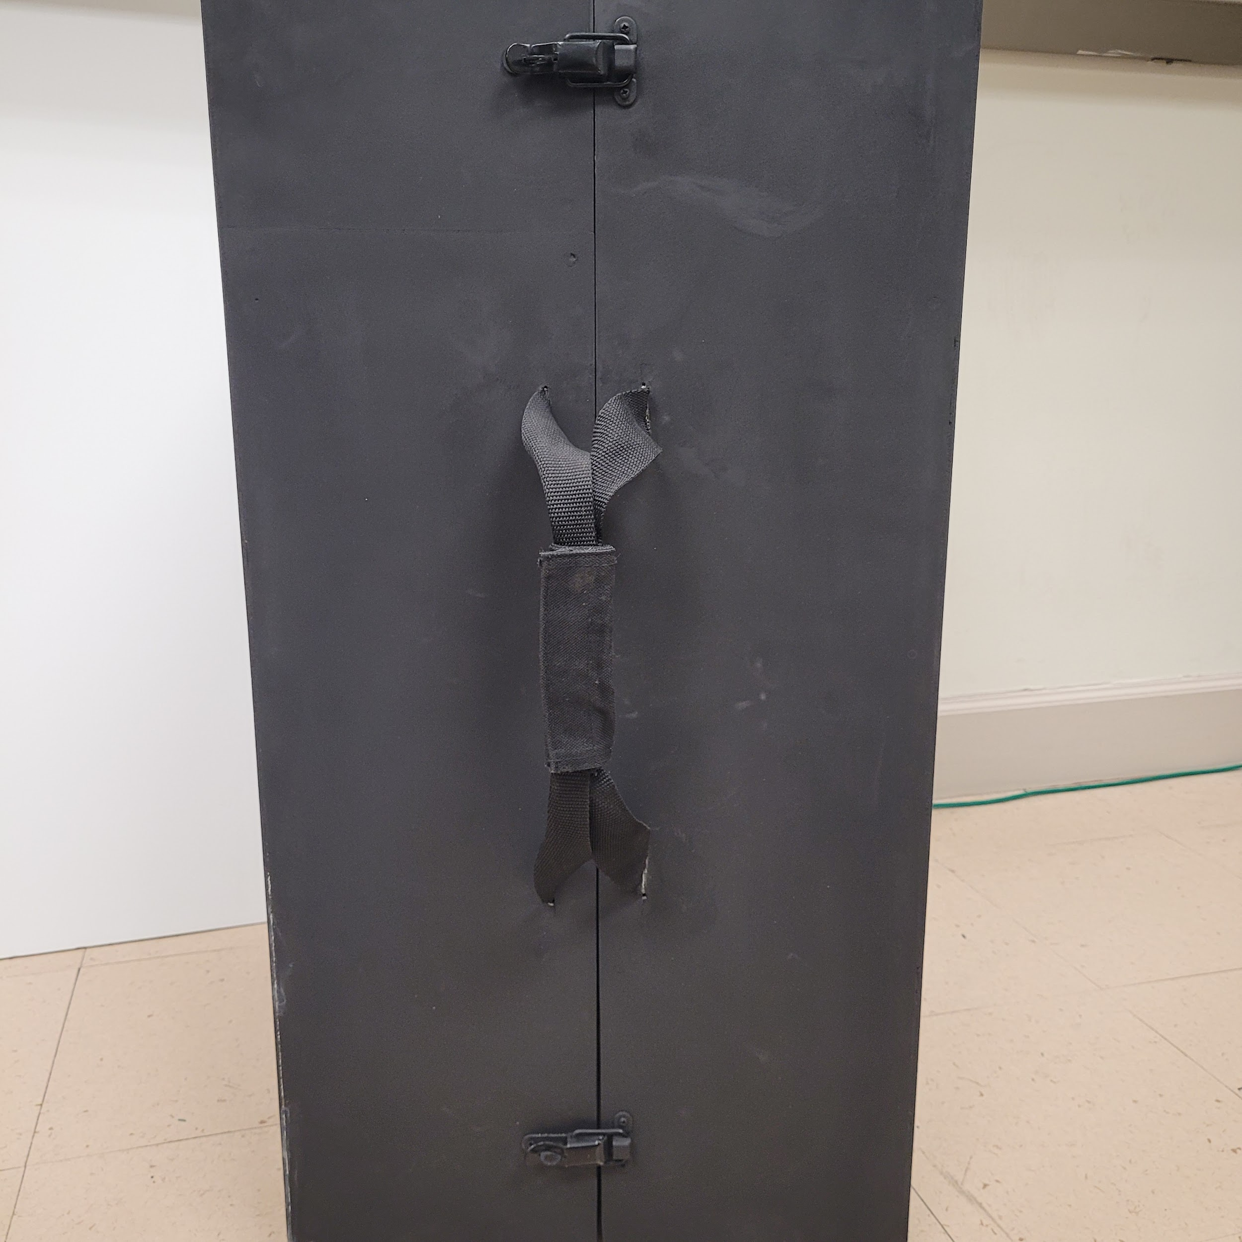
Current Functionality
Portability: Protective Exterior Case Functionality
Constructed Protective case to transport House Model
Constructed using 1x1” dowel and ⅛” hardboard for lightweight and rigidity.
Added locking mechanism to secure case close during transportation and prevent tampering.
Added Carrying handles to allow it to be easily carried.
Notes:
jon

Slide 48
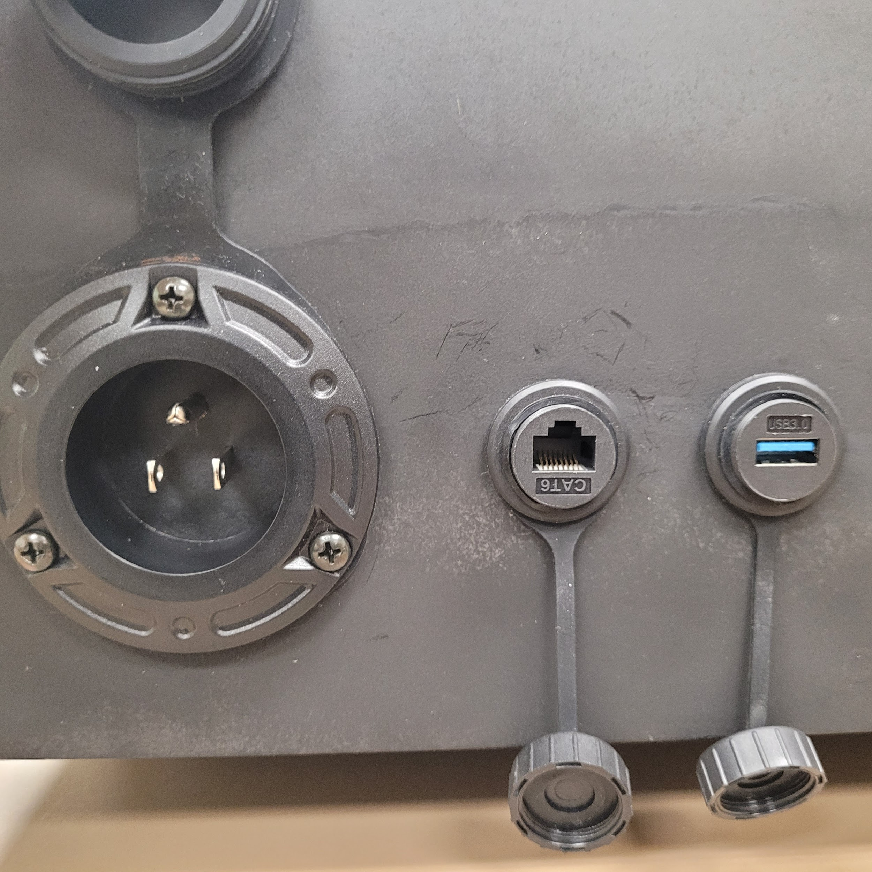
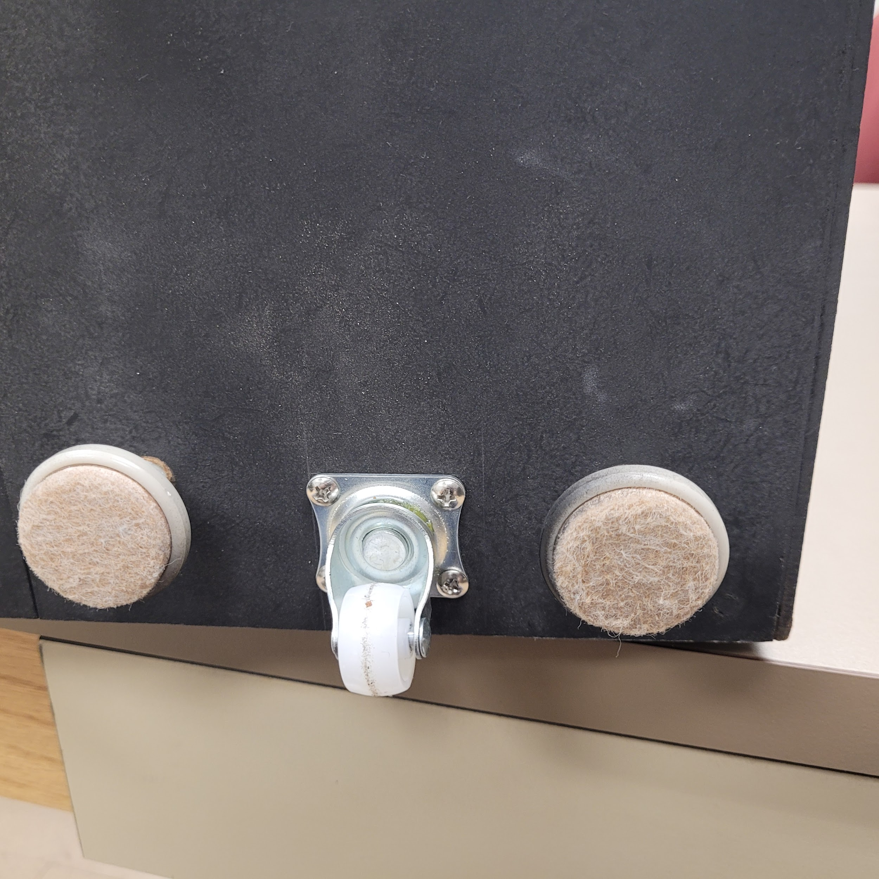
Current Functionality
Portability: Protective Exterior Case Functionality
Added electrical power passthrough to allow for easy setup.
Added Ethernet passthrough to allow the Attack VM to easily be connected the the LAN.
Added USB passthrough to allow the Arduino Mega housed inside the Home model to be easily connected.
Added adjustable feet to allow the Protected case to be stabilized during demonstrations.
Added caster wheel to allow the adjustable feet to be lower and the case to be rolled around during transporting.

Slide 49
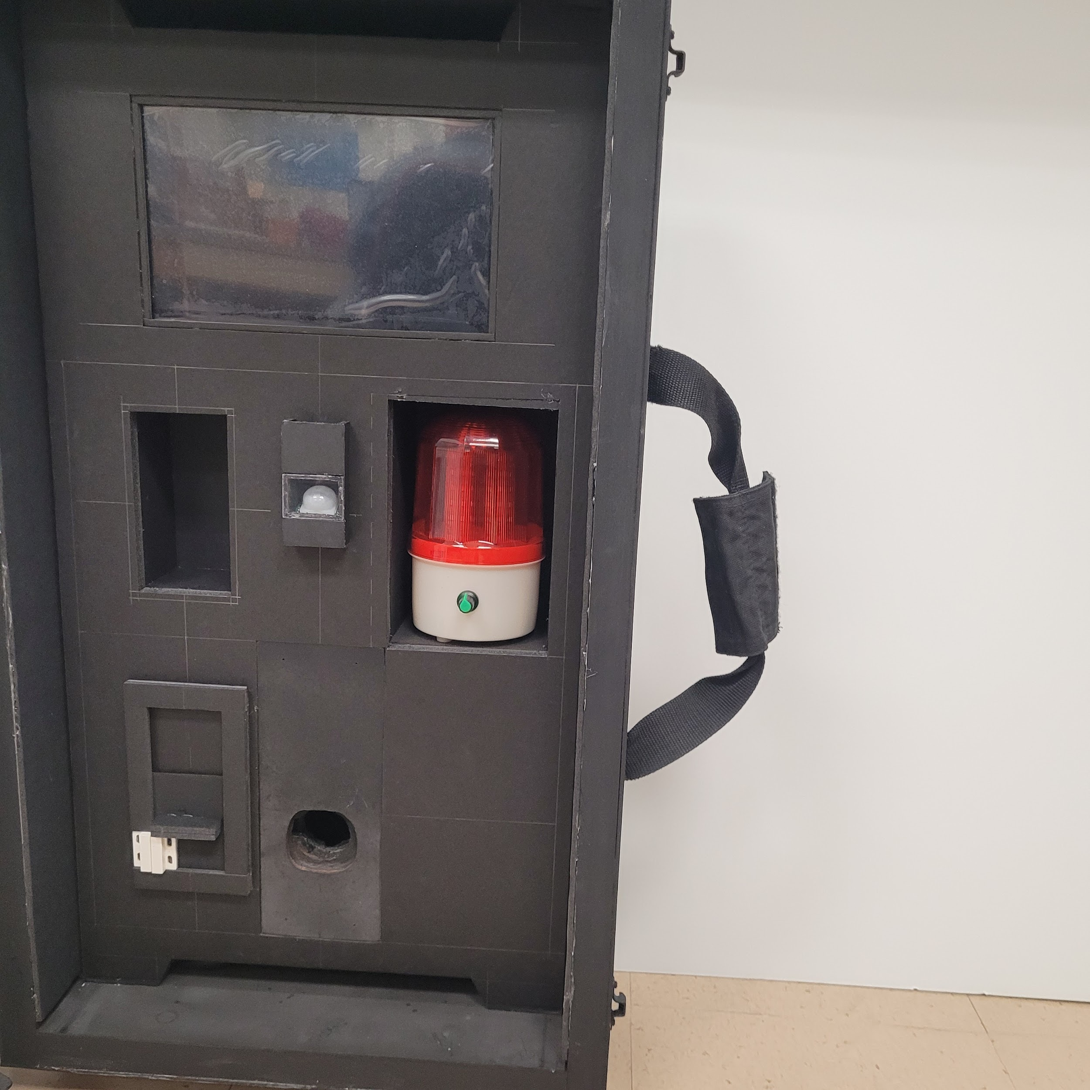
Current Functionality
Hardware: Interactive Panel Features
Installed:
10” touchscreen HMI to display the current state of the system.
Strobing Alarm
IR Beam Break Sensor
Passive IR Motion Sensor
Magnetic Contact Switch
In Progress:
Smart Deadbolt System
Garage Door Remote
1
3
4
2
5
1
2

Slide 50
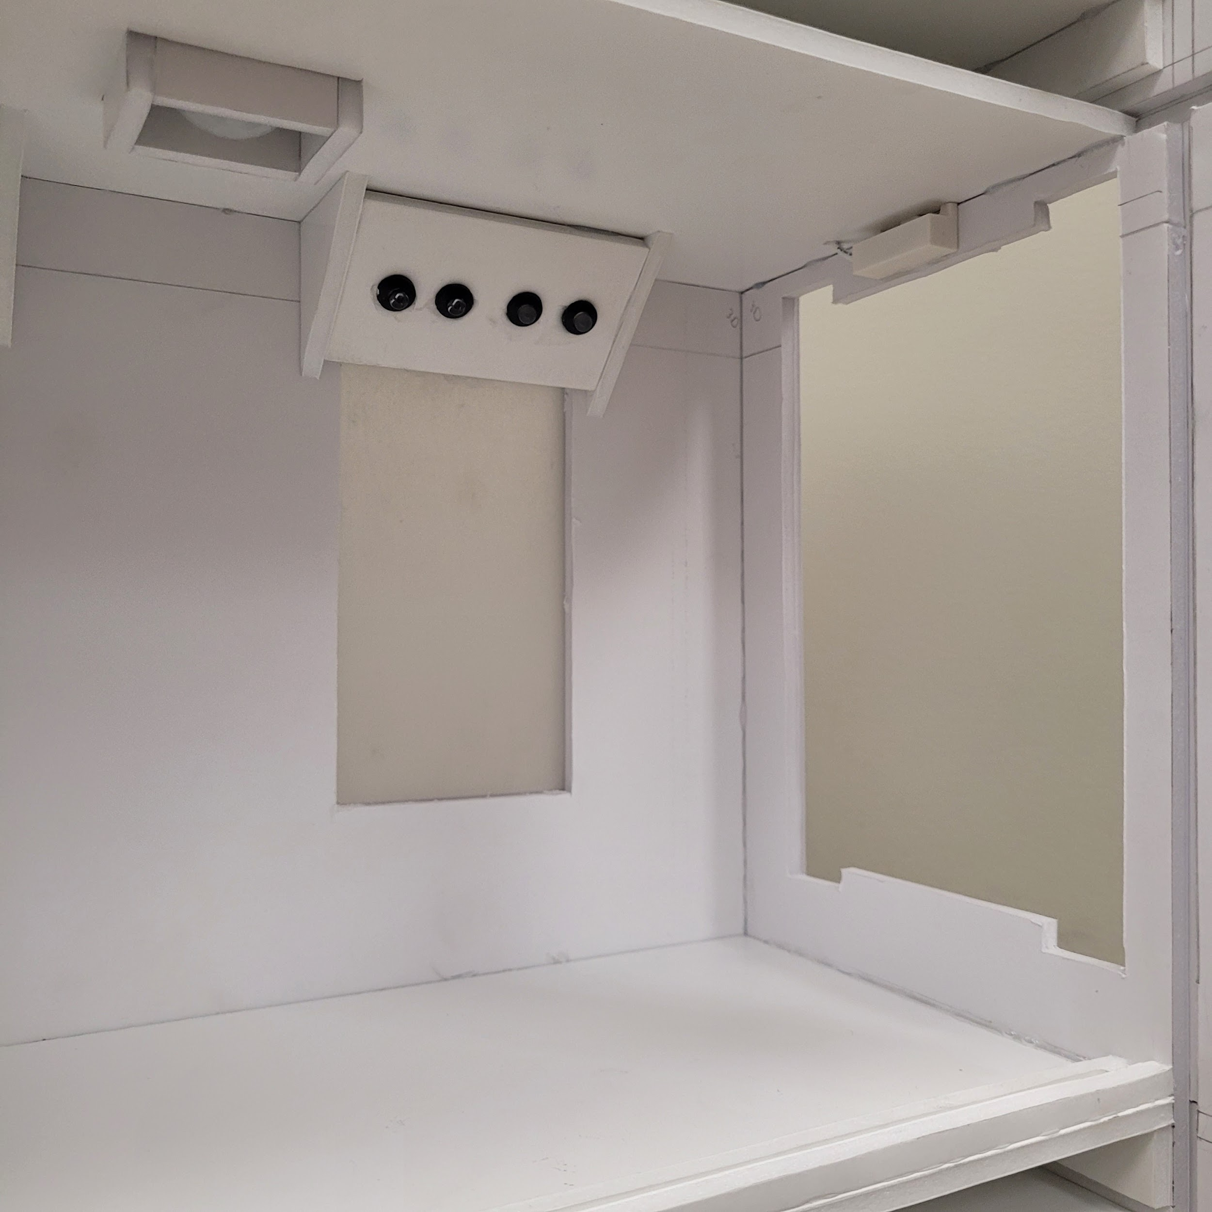
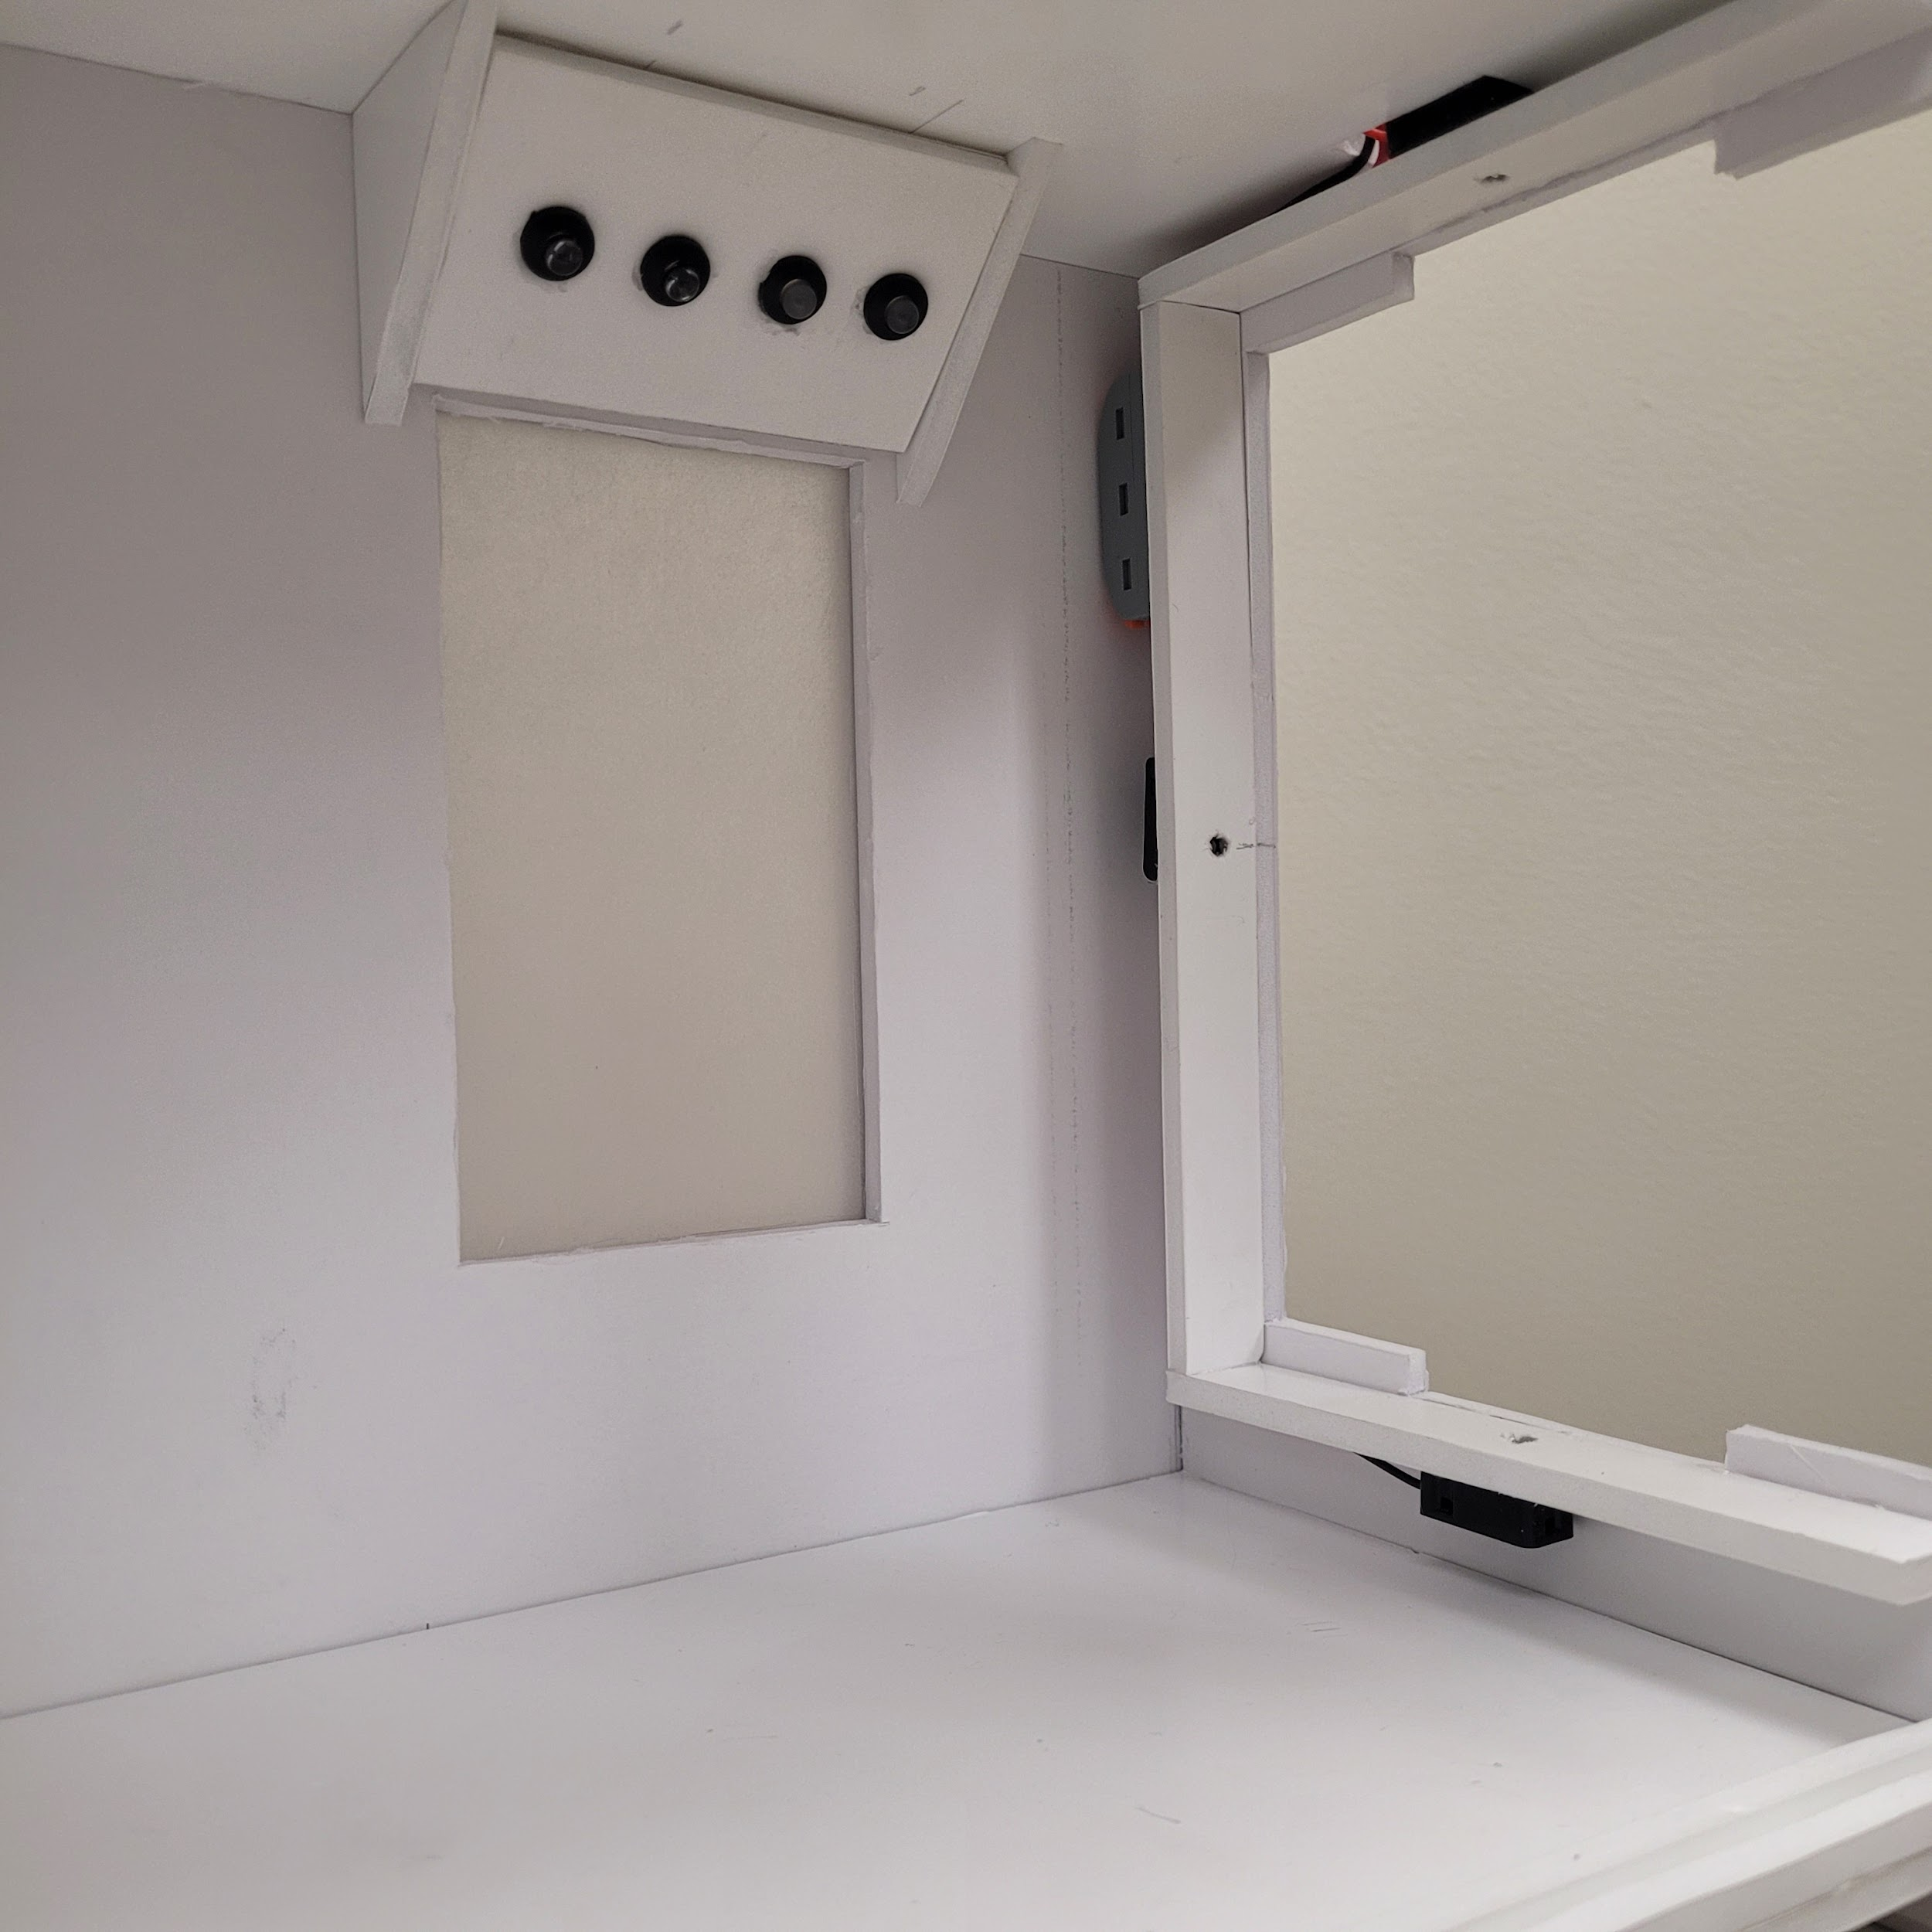
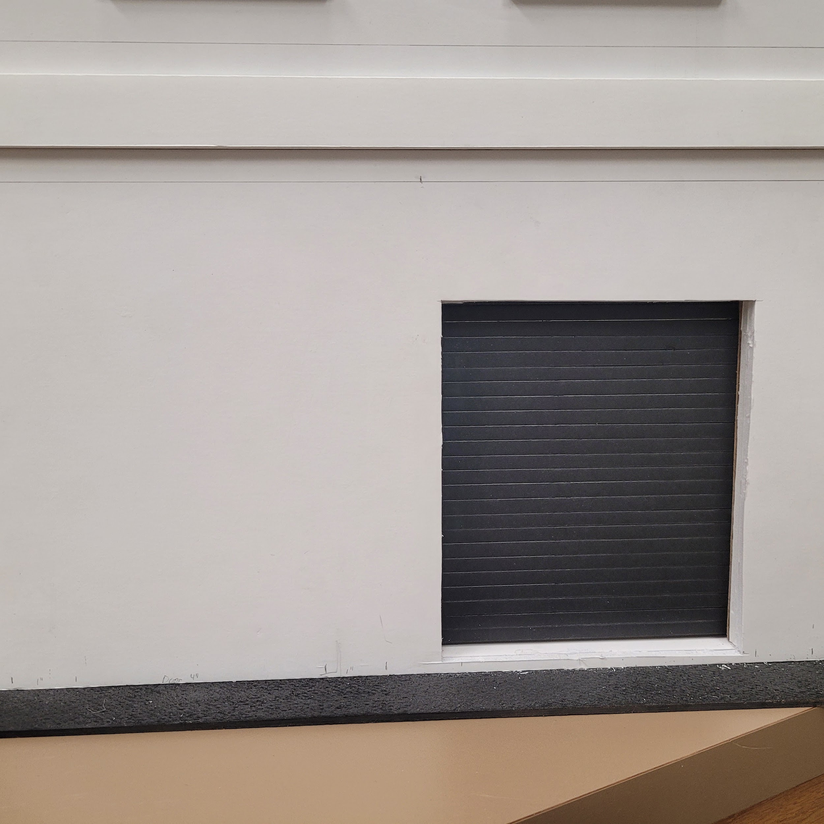
Current Functionality
Hardware: Model Home Features
Installed:
LED Lighting
both white and green for each upper level
IR Beam Break Intrusion Sensor
Passive IR Motion Sensor
Magnetic Contact Switches
Side-window intrusion detection
In Progress:
Model Front Door with Locking Solenoid
Model Rolling Garage Door
3
1
4
L2 Interior
1
1
2
2
L3 Interior
L1 Exterior

Slide 51

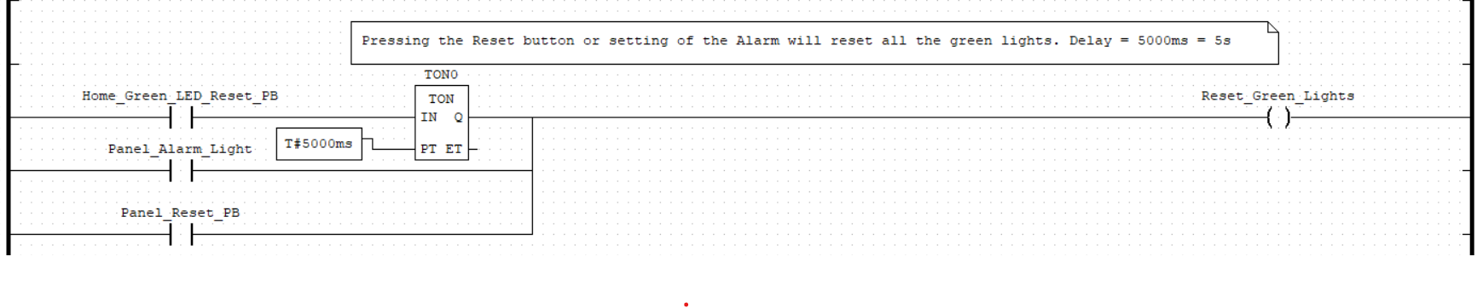
Software: PLC Ladder Logic
OpenPLC is an open-source Programmable Logic Controller (PLC) suite that can create and run PLC programs on custom hardware, such as a Raspberry Pi or an Arduino.
It consists of two main components, the Runtime and the Editor. The Editor was used to create our main program using Ladder Logic programming, and the Runtime executes our program on the target hardware.
Runtime is installed and configured on both a Raspberry Pi 3B and an Arduino Mega 2560r3.
2560 is slaved to the Pi and only provides additional I/O for the system. All logic is run via the master program on the Pi.
Below is an example of part of our Ladder Logic Program:

Slide 52

Software: ScadaBR
ScadaBR is an open-source software that offers all the functionalities of a complete SCADA (Supervisory Control and Data Acquisition) system. SCADA-type software has existed since the late 1960s and is a fundamental part of automating processes involving machines, Programmable Logic Controllers (PLCs), electronic drives, and sensors.
This software allows us to monitor and control the model through a Human Machine Interface (HMI) on the model’s display.
ScadaBR communicates with the OpenPLC runtime on the Raspberry Pi via Modbus, a SCADA network protocol that’s been an industry standard since the 70’s.
Using Modbus, ScadaBR can read and write to the master PLC program’s registers on the Pi, which controls the functionality of the model.

Slide 53
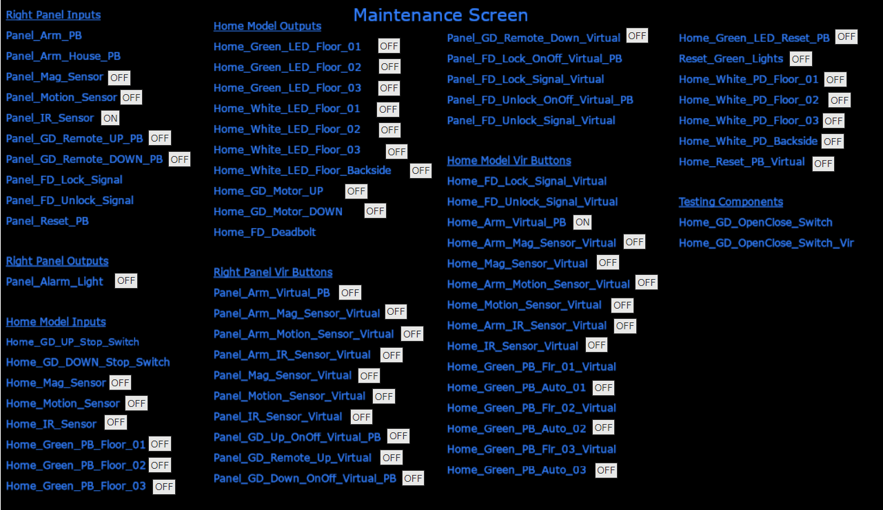
Current Functionality
Software: Human Machine Interface
ScadaBR has been installed and configured on a second Raspberry Pi 3B and connected via Ethernet to the PLC controller.
Provides supervisory control and status monitoring of the system.
Reports to the HMI screen embedded in the right panel of the case.
A test HMI (shown above-right) has been developed based upon the master PLC program. Final visual elements and layout will be developed as system integration is completed.

Slide 54
Current Functionality
Software: Cyber Attacks/Mitigations
Injection Attack/Mitigation
Attack
Allows us to send packets to the PLC that overrule what is sent by the HMI
Method is finalized
Mitigation
Finalized and implemented
ARP Poisoning
Attack
Allows us to establish a MITM stance between the HMI and PLC
Finalized and implemented
Mitigation
Finalized and implemented
In Progress:
Injection Attack: We will have to finish the LL program before we can fully finalize and implement the attack.

Slide 55
Expected Final State
Most of the project lifetime has been experimentation and learning to work with a new (to us) platform.
The remaining work tasks consist of final assembly, integration testing, and final bug fixing with each phase expected to take no more than a week.
<1 week to finish wiring and assembly.
<1 week to complete final testing and corrections.
Remaining project time will be spent finalizing documentation and deliverables.
We fully expect to meet all project requirements at time of delivery.
There is enough inbuilt redundancy in the number of components to allow for removal of one or two should we be unable to complete the integration.
This is extremely unlikely, given our completed testing, but still an available option.

Slide 56
Future Additions
The final product will be functionally complete, but additional features could still be added or improvements made.
The visual appeal of the model could be increased in a few ways:
More sophisticated/professional detailing of the model home
More subtle integration of the sensors into the model
More eye-catching and attention-grabbing outer visual design
Attack demonstration library could be expanded:
More technically complicated attacks
More variety in generated effects
Viewer interaction could be further developed.
Could better gamify the demonstration to generate greater viewer investment.
Foundational components would be very similar but would likely require a complete redesign of the system. Likely better suited as a new project than an extension of the current.

Slide 57
Lessons Learned
Ladder Logic programs are deceptively simple.
Core operation is simply conditional output as a function of input. (i.e. if x do y)
However, chaining even a modest system of multiple inputs and outputs can get very complicated very quickly.
The simplicity of ladder logic can also result in a single condition requiring multiple rungs of logic to implement.
Gained a better understanding of the engineering design process.
It is important to not only work well independently but also as a team to reach an expected outcome.
Start early!
Unexpected delays and complications will rapidly consume any schedule slack.

Slide 58
Project Q/A

